Slide 1


Capstone Project
Done by: Rahul Purbhoo and Darshna Purbhoo

Slide 2

Revision Control
What is revision control (also known as source control and version control)?
A Revision Control System records all the changes made to a file(or source code) or set of files, incase a version is ever needed going forward.
It ensures that everyone in a team or individually are working on the latest version, also allows them to work simultaneously on the project.
Helps managing and protecting the source code.
Keeps track of all the modifications made to the code

Slide 3
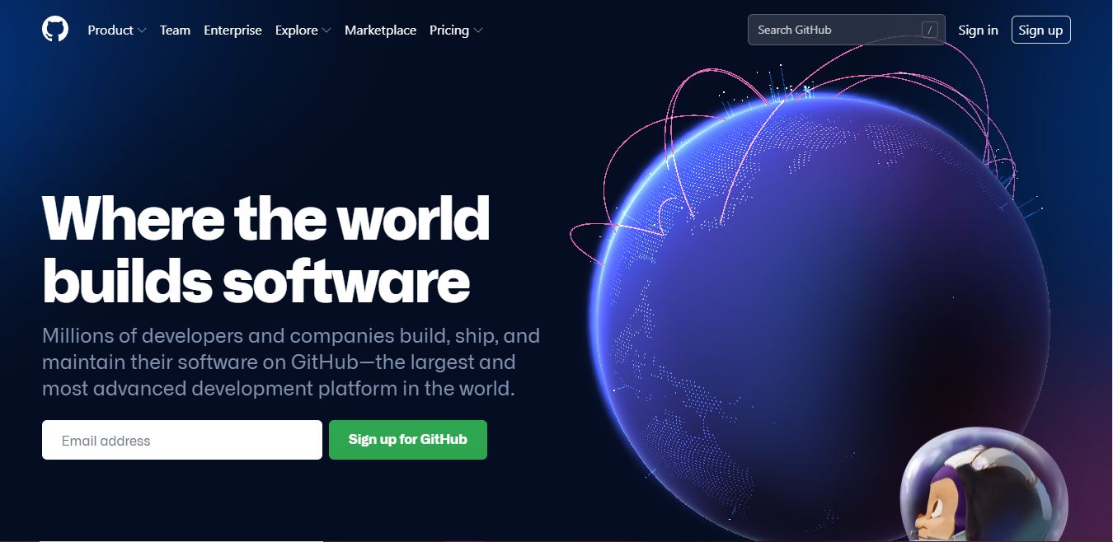
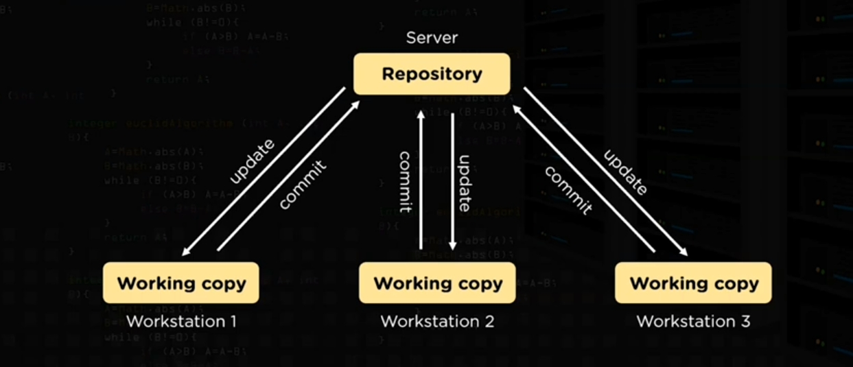
Sign into your account.
Download github.
Create repository and commit regularly, while working.

Slide 4
Data persistence
Data that is saved onto the databases
Data that will be modified the least, infrequently visited, that is meant to last for a long time which is close to permanent.

Slide 5
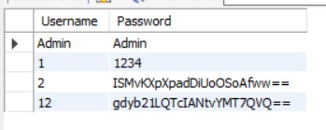
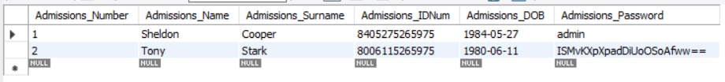
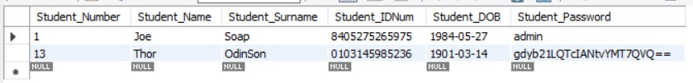
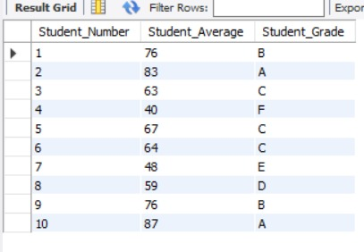
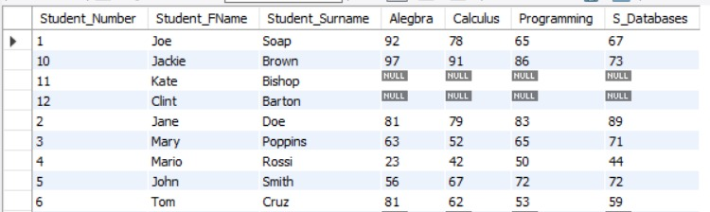
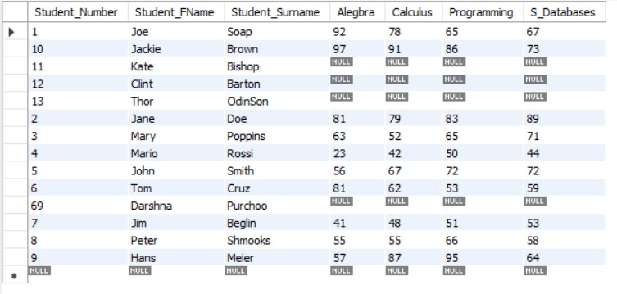
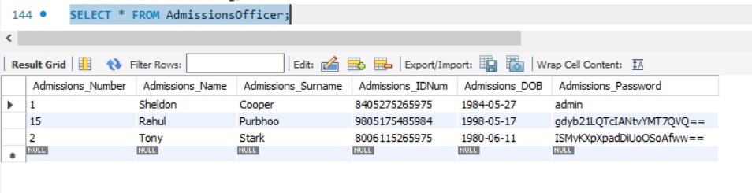
Database tables

Slide 6
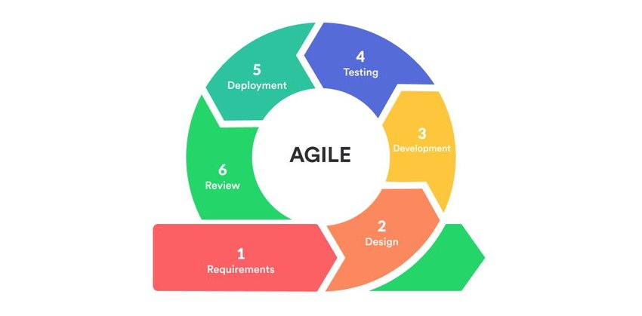
Agile systems
Agile methodology is a way to approach a project by breaking it up into several phases
1. Project planning: Understanding scope Planning and estimating budget Define project goal Review project | 4 Testing Run application Fix up any errors Run program again
2. Design Understanding requirements Create user story Assess complexity Define criteria Setup team Decide applicability | 5. Deployment Commit to a secure platform like Github Configure Move to cloud
3. Execution Creating program Updating design doc Detail tasks breakup | 6. Review What went well? Demo and discussions Check feasibility

Slide 7
Class diagram
Use cases describing the process of what a student does.
Use cases describing what the admissions team does.
College Student Enrolment
Create student profile
Create temporary Student ID
Log in
Admissions Log in
Submit application
Assess Student’s application
Student
View application status
Admissions team
Shows the relationship between the student and admissions team
Review Student’s application
Primary Actor: Person who is using the system.
Edit information
Secondary Actor: Retrieves application and responds.
Log out

Slide 8
Start
Activity diagram
Fill out application forms
Go to college website.
Are you registered ?
Register
No
Obtain help to fill out forms
Yes
Log in
student
View application status.
Who are you?
Admissions officer
View applications
update application’s status
End
Log out

Slide 9
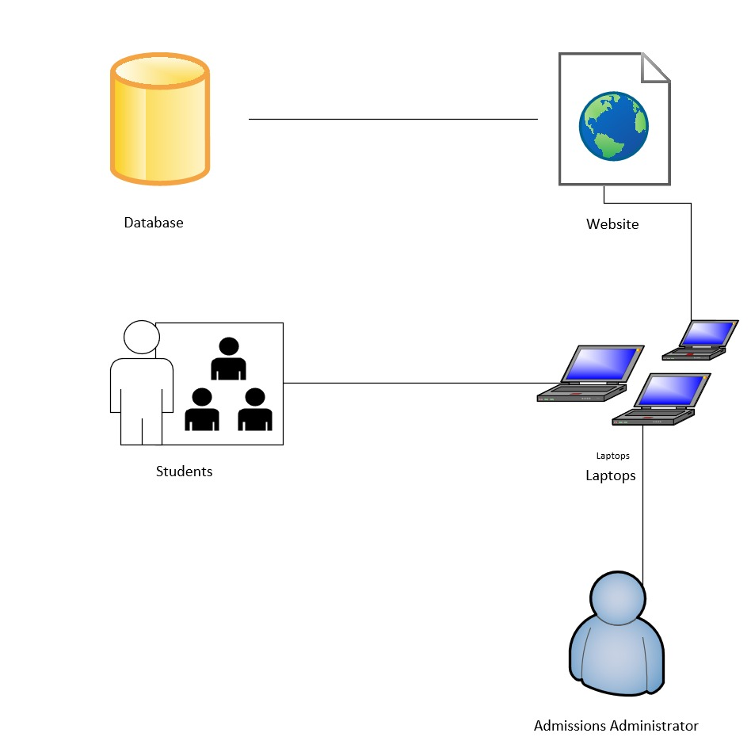
system diagram
Stores the data of applications and students.
Access applications via the website of the college.
Medium of accessing their applications and connecting to the website.
Submits an application and checks whether or not they have been accepted.
Retrieves the applications, assesses it and responds to the applications.

Slide 10
User stories: student
No. | User story | Acceptance Criteria | Acceptance Test
1 | As a Student: The website should be user friendly- I would like to be able to enrol/ apply for enrolment easily. | The Student will be redirected to the Application Forms, when they try to access the College website. | The student should be able to easily access the application forms.
2 | As a Student: I would like to create/activate a profile on the digital platform on the college website. | Given that the student wishes to create a profile, when they click the “Create a Profile” button, they should be redirected to a page that enables them to fill in the necessary Information. | The student should be able to successfully create a profile.
3 | As a Student: I want to be able to login to my profile to view the status of my application. | Given that the student logs in to their profile with their created Username and Password, they should be able to view their application status. | The student should be able to Login and view the status of their application.
4 | As a Student: I would like to receive assistance with my application that I am on the right track. | Given that the student requires assistance with the application, they should be redirected to the contact details for helplines. | The student should receive the required assistance.
5 | As a Student: I would like to easily be able to login or logout of the system. | When Clicking on the “Login” or “Logout” buttons, they should be redirected to the home page. | The student should be able to successfully login and out of the website.
6 | As a Student: I want to ensure my details are safe, remain confidential and will not be disclosed to a third party that would be misused. | The Student should be redirected to the privacy policies. | The student should be rest assured that other than the College, no third party can access their information.

Slide 11
User stories: admins team
No | User story | Acceptance Criteria | Acceptances Tests
1 | As an Admissions Officer: I would like to be able to create an admin user profile. | Given that the Admissions Officer wants to create a profile, they will be redirected to the admin application form. | The Admissions Officer should be able to successfully create the Admin Profile.
2 | As an Admissions Officer: I would like to be able to access the website to be able to assess the students application. | Given that the admissions officer wants to access the website they will be redirected to the page with student applications and they will have certain privileges. | The admissions officer should be able to successfully gain access to the website with the privileges.
3 | As an Admissions Officer: I would like to be able to review and update the Status of the students application. | Given that the admissions officer wants to update the status of the student application, he will be given the option to update the status. | The admissions officer should be successfully able to update the status of the students application.
4 | As an Admissions Officer: I would like to be able to request help from higher authorities, due to me having limited authority. | The admissions Officer should be given an option to be able to forward queries to higher authorities. | The admissions officer is successfully able to forward queries to higher authorities.
5 | As an Admissions Officer: I would like to be able to keep up to the confidentiality of the students privacy. | The admissions officer should be able to keep their work protected by their user specific username and password in order to protect the confidentiality of the students. | The admissions officer should be able to change their password from the default one to a user specific, in order to maintain the confidentiality.

Slide 12
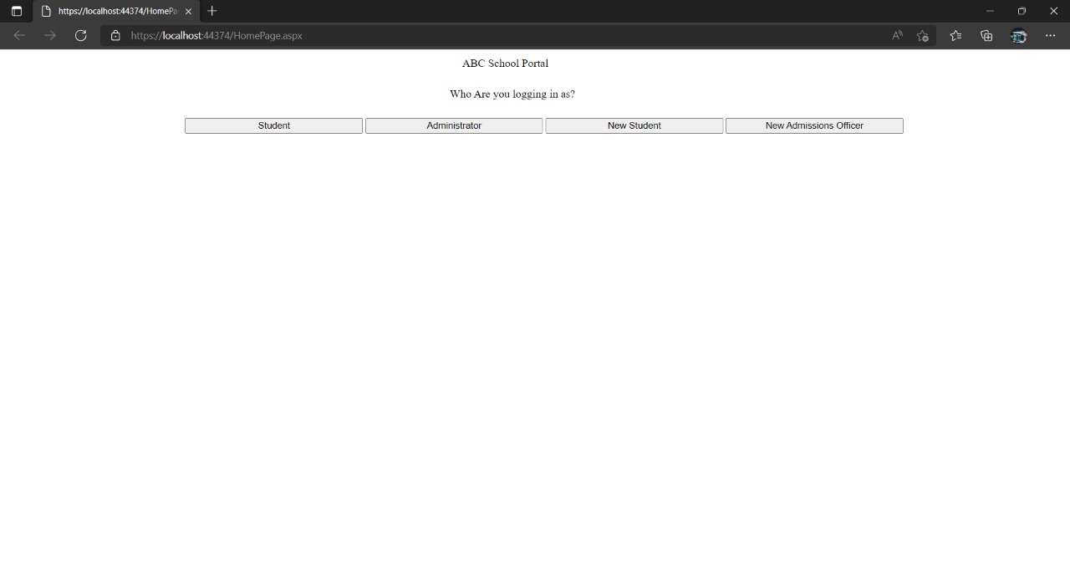
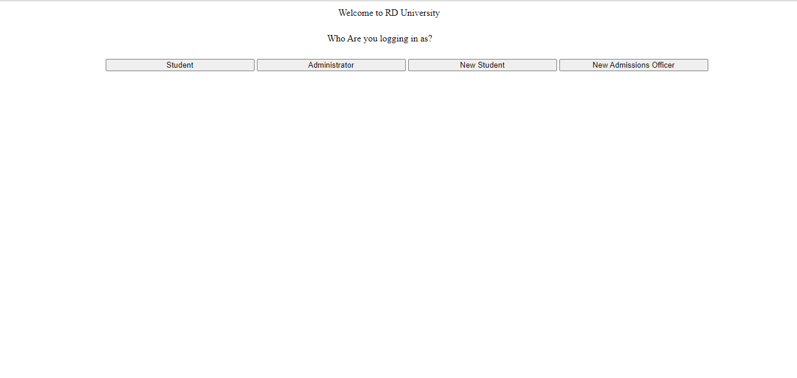
The RD University Homepage

Slide 13
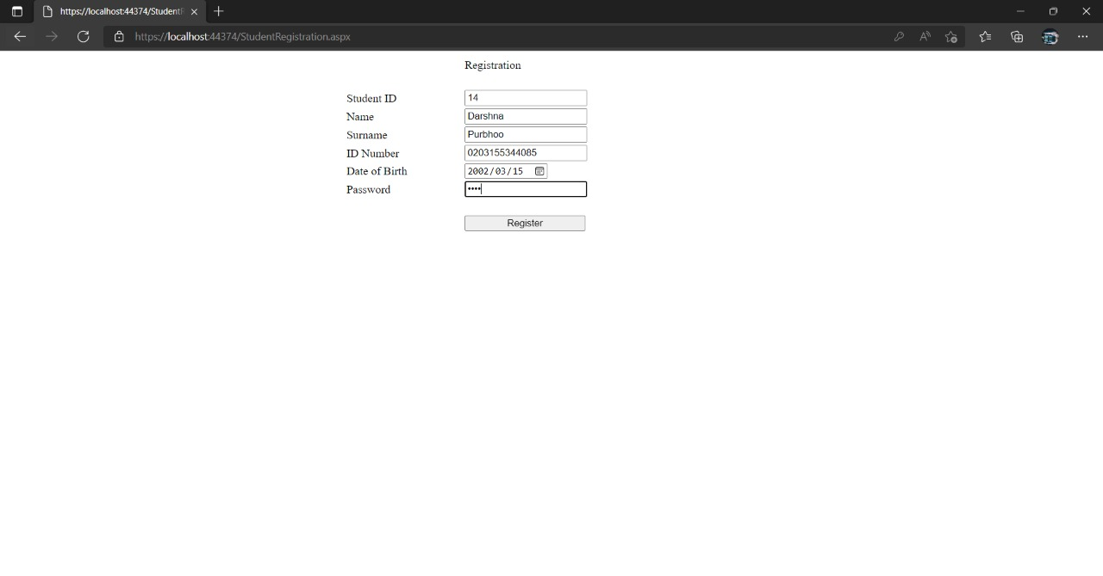
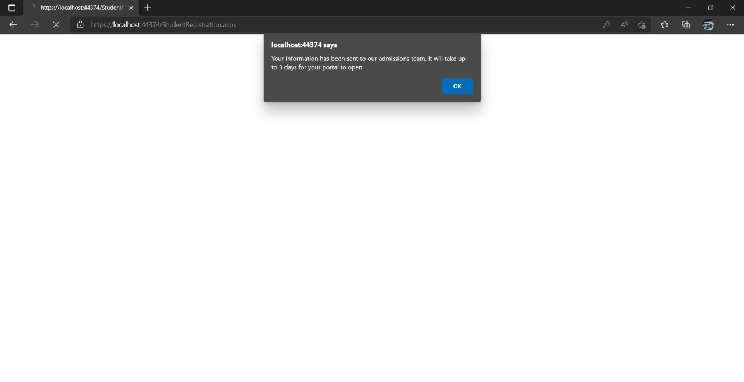
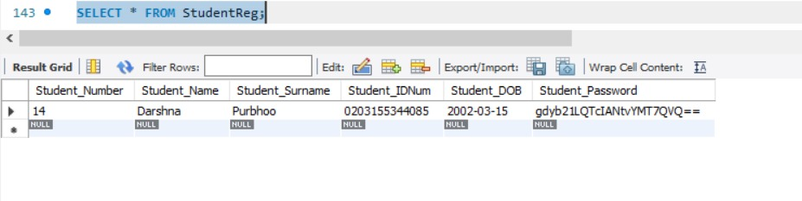
Student registers
Student account is created
Student gets added to database

Slide 14
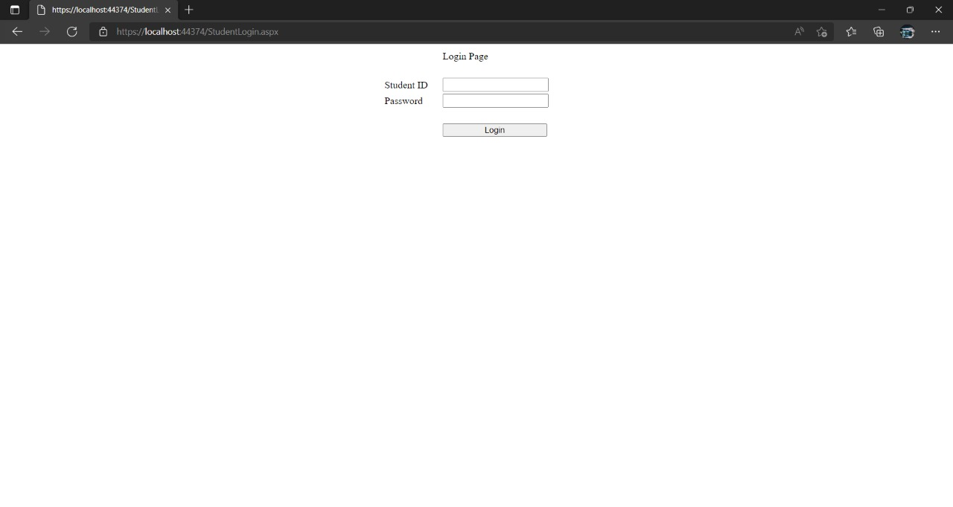
Student’s login

Slide 15
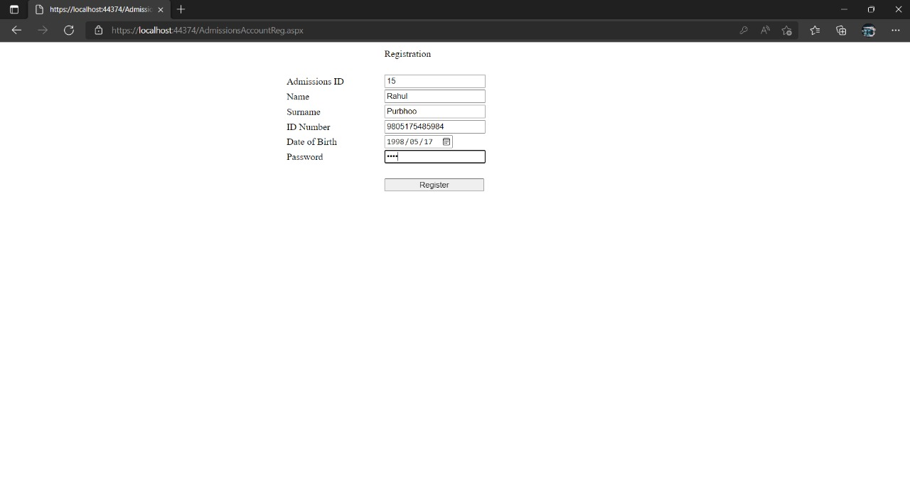
Admissions officer creates Admin account

Slide 16
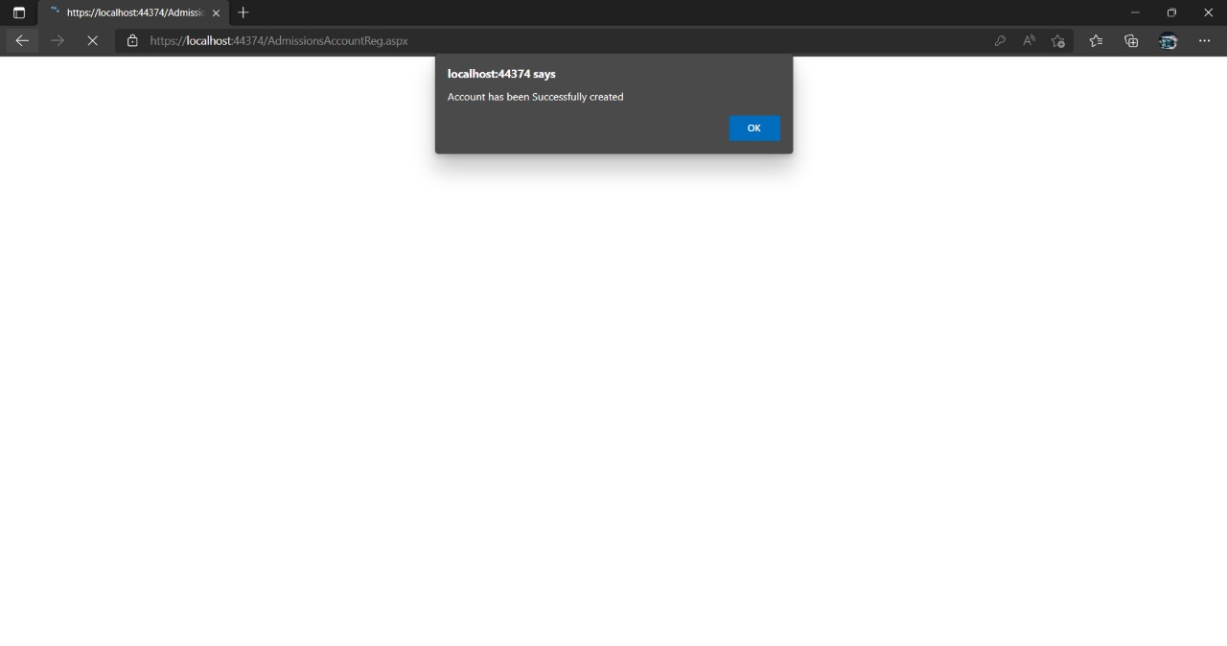
Admissions officers account created

Slide 17
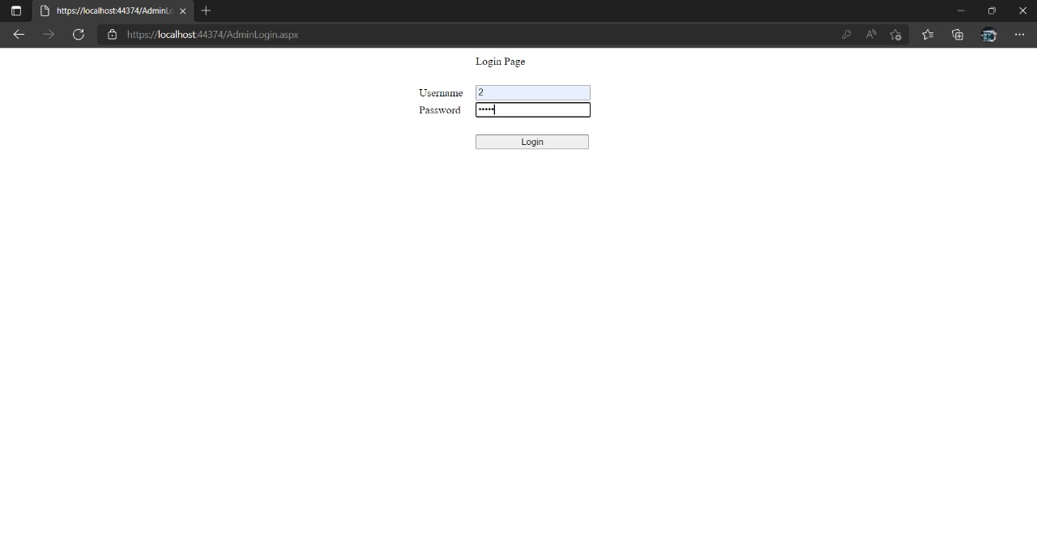
Admin login

Slide 18
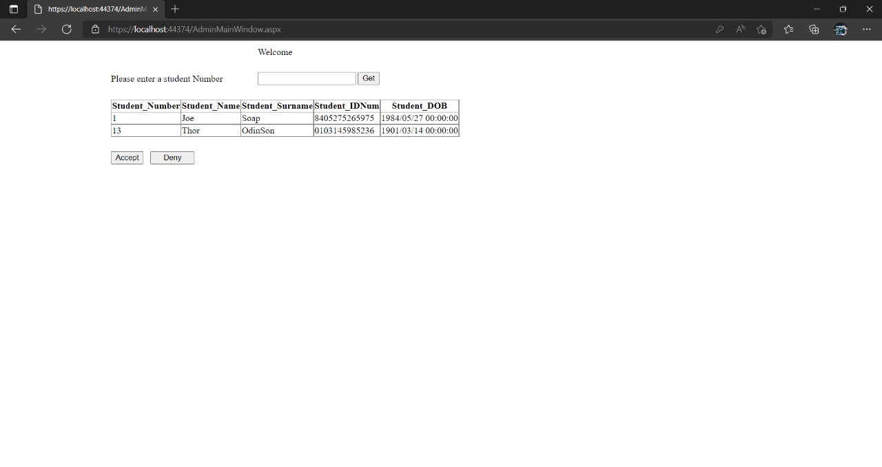
Viewing the list of students that have applied.

Slide 19
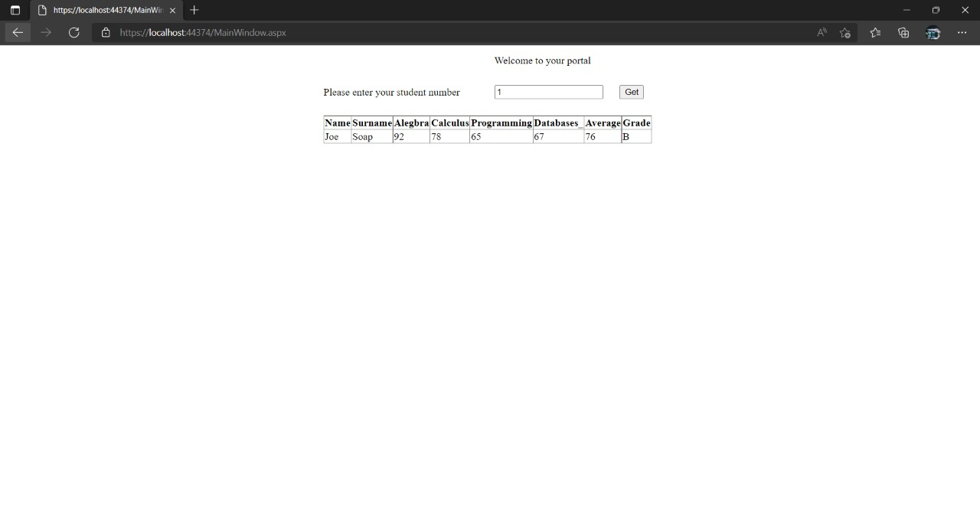
Assessing the Students application.

Slide 20
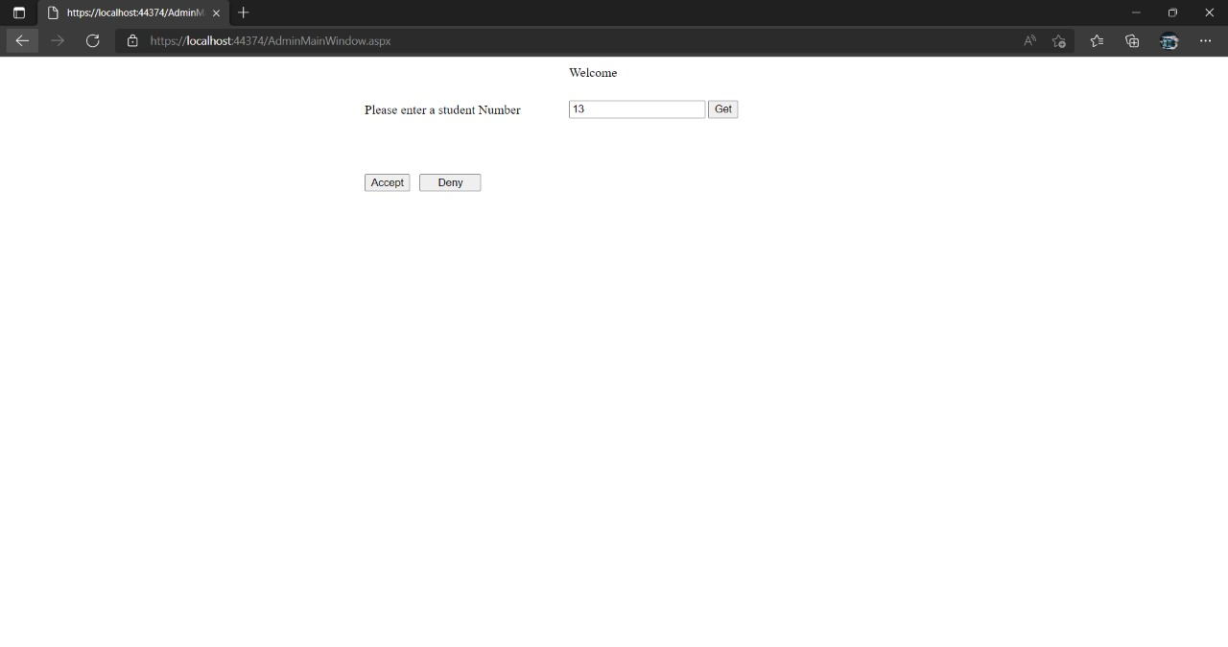
Demo.
Updating status
Screenshots of the webpage.

Slide 21

Status updated

Slide 22
Student Information
Students Grades
StudentID: Varchar
StudentSurname: Char
StudentName: Char
+AssignValues()
StudentID: Varchar
StudentSurname: Char
StudentName: Char
Algebra: Int
Calculus: Int
Programming: Int
Databases: Int
+AddStudentGrades()
+DivideByFour()
+AssignGrade()
Database design
Students Account to Create
StudentID: Varchar
StudentName: Char
StudentEmail: VarChar
StudentClass: VarChar
SendNotiToStudent()
CreateAccount()
RecordToStudentInfo()
SendNotiToStudent()
Grades
StudentID: Varchar
Average: Int
Grades: Char
+AssignAverage()
+AssignGrades()

Slide 23
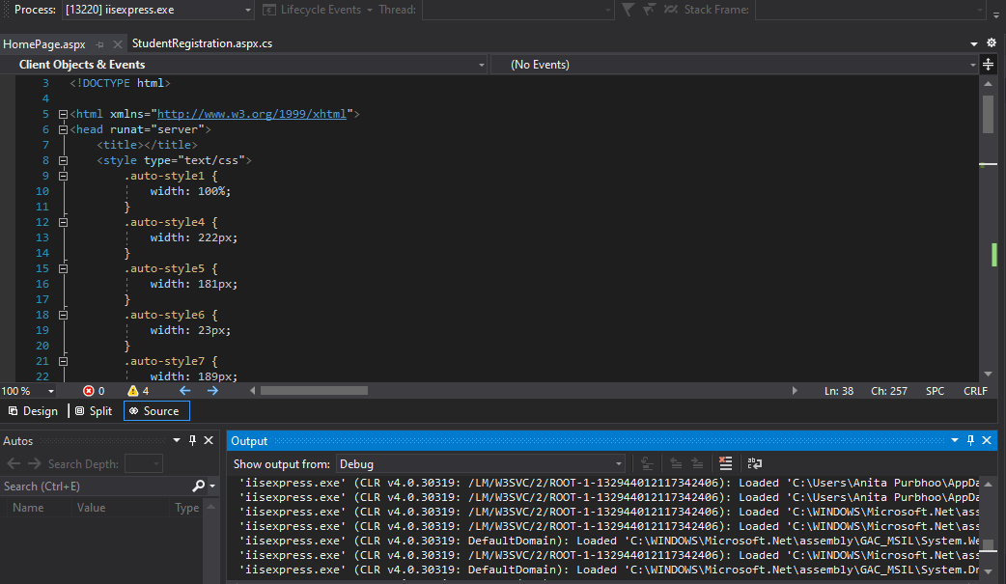
Troubleshooting and testing
Logging + postman screenshots

Slide 24
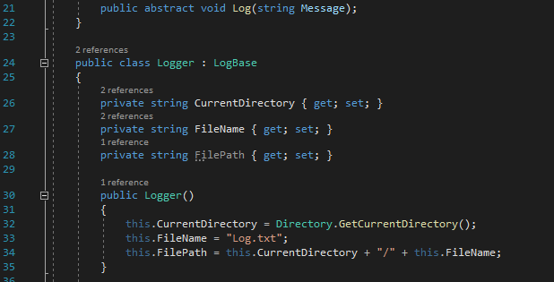
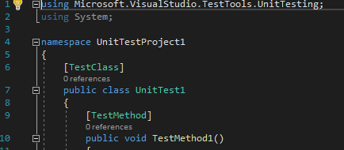
Logging
Unit testing.

Slide 25
Room for improvement
The room for changes could be for the administrator to input students grades and the system would calculate and assign them an average
Also the admin team could have access to mote features such as attendance tracking

Slide 26

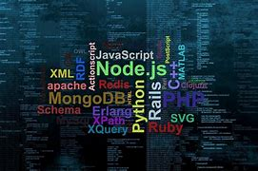
How have I become a better developer with this course?
It showed us the tools that we can use in the industry
Also taught us how to approach technical problems
How to plan and approach projects
Taught us about a platform to safekeep our work in case a mishap like your laptop gets stolen, we would not have to start from scratch.
Programming languages and Interface
Front-end
HTML
CSS
Back-end
C#
ASP.NET

